Slide 1


Slide 3
Elevator pitch IP2017 // AP ft. OAMK
Group 2b // e-health
“Health technology project (measuring sports via ECG)”
Nick cuypers // Koen schauwaert // Peura Ukko-Pekka

Slide 4

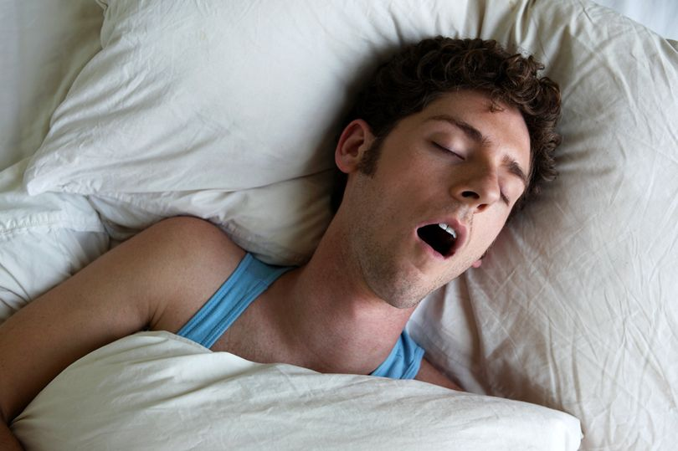
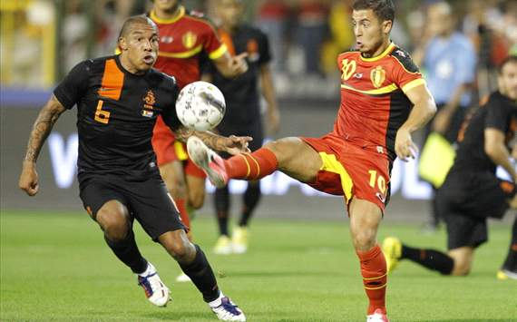
problem

Slide 5
PROBLEM
Sport on your own
Sport with a team
Friends
Professional

Slide 6

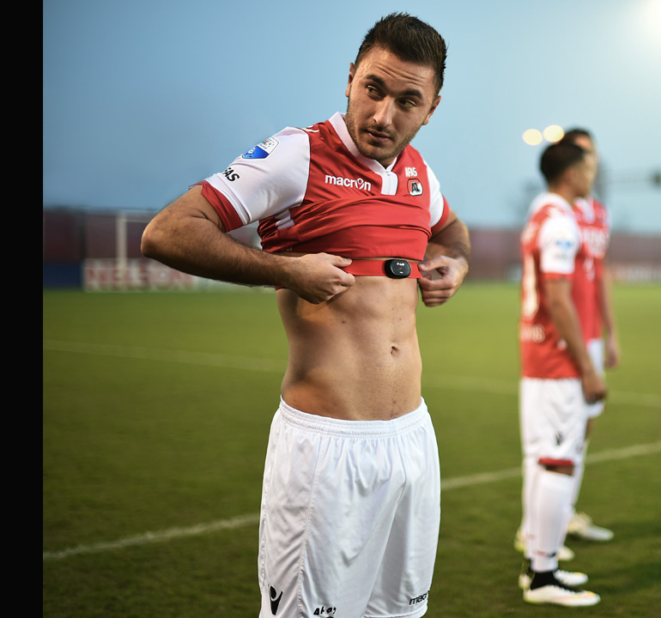
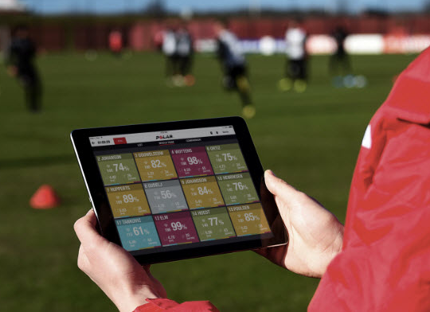
PROBLEM

Slide 7
PROBLEM
€ 70

Slide 8

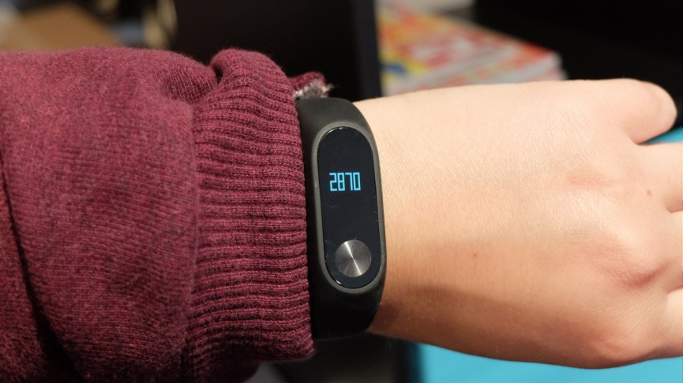
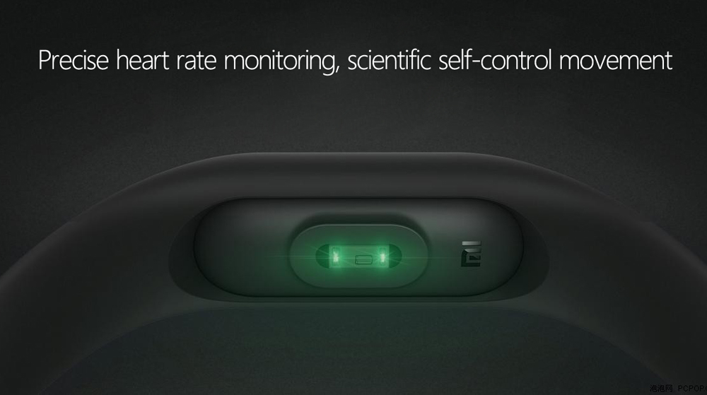
PROBLEM

Slide 9
PROBLEM
€ 30

Slide 10


Slide 11


Slide 12
SOLUTION
We will produce and develop

Slide 13
SOLUTION
We will produce and develop
a wearable

Slide 14
SOLUTION
We will produce and develop
a wearable
PULSE (heartbeat) MONITOR

Slide 15
SOLUTION
We will produce and develop
a wearable
PULSE (heartbeat) MONITOR
to monitor your own heartbeat

Slide 16
SOLUTION
We will produce and develop
a wearable
PULSE (heartbeat) MONITOR
to monitor your own heartbeat
AND

Slide 17
SOLUTION
We will produce and develop
a wearable
PULSE (heartbeat) MONITOR
to monitor your own heartbeat
AND
that of your team

Slide 18
SOLUTION
We will produce and develop
a wearable
PULSE (heartbeat) MONITOR
to monitor your own heartbeat
AND
that of your team
to keep track of your and their health and fitness

Slide 19
SOLUTION
We will produce and develop
a wearable
PULSE (heartbeat) MONITOR
to monitor your own heartbeat
AND
that of your team
to keep track of your and their health and fitness
which data will be stored on your smartphone

Slide 20
SOLUTION
We will produce and develop
a wearable
PULSE (heartbeat) MONITOR
to monitor your own heartbeat
AND
that of your team
to keep track of your and their health and fitness
which data will be stored on your smartphone
via bluetooth

Slide 21
SOLUTION
We will produce and develop
a wearable
PULSE (heartbeat) MONITOR
to monitor your own heartbeat
AND
that of your team
to keep track of your and their health and fitness
which data will be stored on your smartphone
via bluetooth
so you can read out it’s data

Slide 22
SOLUTION
We will produce and develop
a wearable
PULSE (heartbeat) MONITOR
to monitor your own heartbeat
AND
that of your team
to keep track of your and their health and fitness
which data will be stored on your smartphone
via bluetooth
so you can read out it’s data
and share it among friends

Slide 23

solution

Slide 24

SOLUTION
3 sensors instead of 1:
Electrical (pulse measuring)
2 Optical (pulse measuring)

Slide 25

SOLUTION
2 sensors instead of 1:
Electrical (pulse measuring)
Optical (pulse measuring)
Comfortable wearing

Slide 26

SOLUTION
2 sensors instead of 1:
Electrical (pulse measuring)
Optical (pulse measuring)
Comfortable wearing
Cheap
€ 45

Slide 27

SOLUTION
2 sensors instead of 1:
Electrical (pulse measuring)
Optical (pulse measuring)
Comfortable wearing
Cheap
2 modes:
Solo
Team: professional // friends

Slide 28
Solution // Hardware
SoC: nRF51822
- ARM Cortex M0
Bluetooth Low Energy
128KB flash
16KB RAM

Slide 29
Solution // Hardware
SoC: nRF51822
- ARM Cortex M0
Bluetooth Low Energy
128KB flash
16KB RAM
Mounted on a wristband (smartwatch)

Slide 30
Solution // Hardware
SoC: nRF51822
- ARM Cortex M0
Bluetooth Low Energy
128KB flash
16KB RAM
Mounted on a wristband (smartwatch)
Sensorfusion:
Optical
Electrical

Slide 31
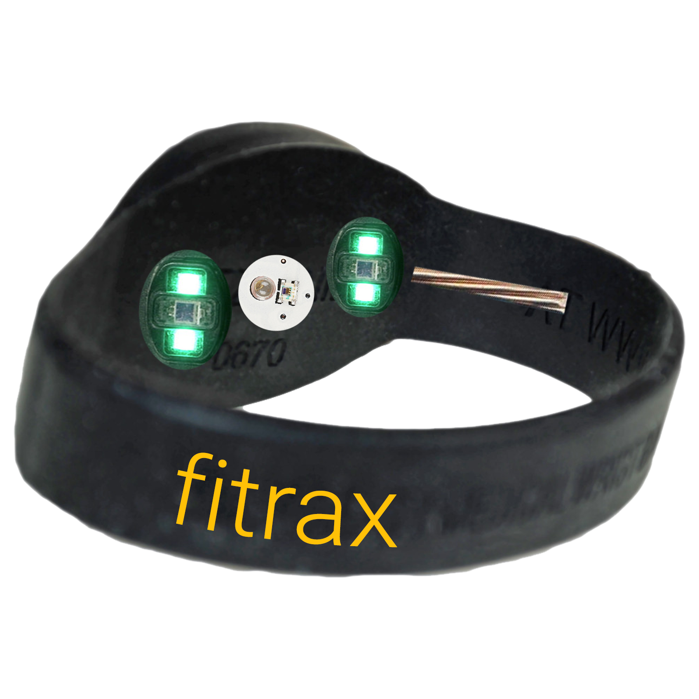
Solution // hardware
Optical sensors
Electrical sensor
Electrical conductor

Slide 32
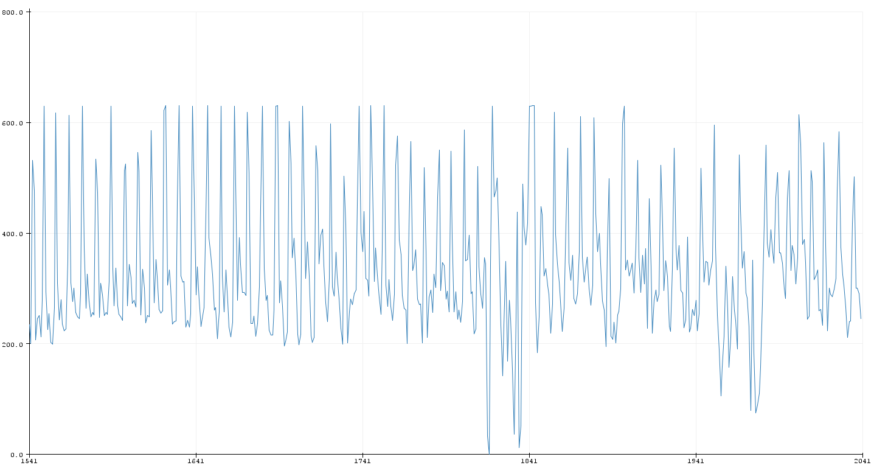
Measurements
Raw data
Noise

Slide 33
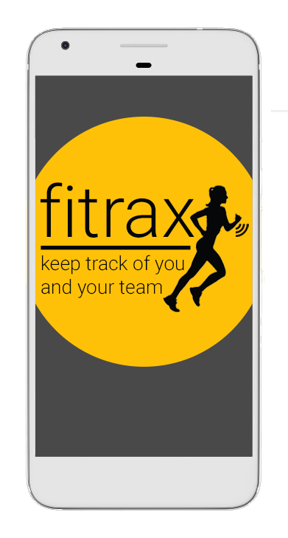
App // SOFTWARE
GPS
Accelerometer
Stepcounter
Add friends and be social
Compose your own teams and
compete!

Slide 34
App // SOFTWARE
GPS
Accelerometer
Stepcounter
Add friends and be social
Compose your own teamsand
compete!
As extension of the wristband

Slide 35
Vision
Multiple models (GPS)
POLAR €600

Slide 36
Vision
Multiple models (GPS)
POLAR €600
We aim for a lower price!

Slide 37

questions

